Slide 1

Transfer Learning Transfer Learning through Semi-supervised Deep Generative Models

Slide 2
Outline
Autoencoders
Variational autoencoders

Slide 3
Autoencoders

Slide 4
What are autoencoders
A particular kind of learning architectures.
A mechanism of compressing its input in a form that can be decompressed.
Similar to MP3 that compresses music and JPG that compresses images.
Autoencoders are more general than MP3 or JPG.
Usually is used to reduce the dimensionality of the data or find a representation that is better for another task.
They are also used to blend inputs from one input to another.
Commonly used for denoising

Slide 5
History
MP3 can compress music files by a factor of 10, so it allowed to burn CDs or MP3-players to store a lot of music.
Same with JPG, compresses images by a factor of 10-20.
This helped lead to the image-rich web and abundance of music that we enjoy today.
We say that both MP3 and JPG take an input (a music or image file), and encode it into a compressed form.
Then we decode or decompress the intermediate version to some lower quality original version.

Slide 6
Lossless and Lossy Encoding
The greater the difference of the original version and the decompressed version the greater the loss.
For example imagine you are in Boston and it is cold and want to write a text to a friend who is having her birthday.
HANNAH HAPPY BIRTHDAY BEST WISHES DAN
Boston is cold (-20C) and I do not want to have my hands out in the cold, so I want to shorten the message. I can remove all vowels
HNNH HPP BRTHD BST WSHS FRM DN
I started with 46 characters and compress them to 29

Slide 7
Lossless and Lossy Encoding (cont)
HPP BRTHD is unambiguous, but DN could mean Dan or Diane.
A way to test if a transformation is lossy or lossless is to consider if it can be inverted, or run backwards, to provide us with the original data.

Slide 8
MP3 and JPG on an image
original
MP3
JPG
Original image 256x256=262,000, MP3=37,000, and JPG=26,000
Image taken from A. Glassner, Deep Learning, Vol. 2: From Basics to Practice

Slide 9
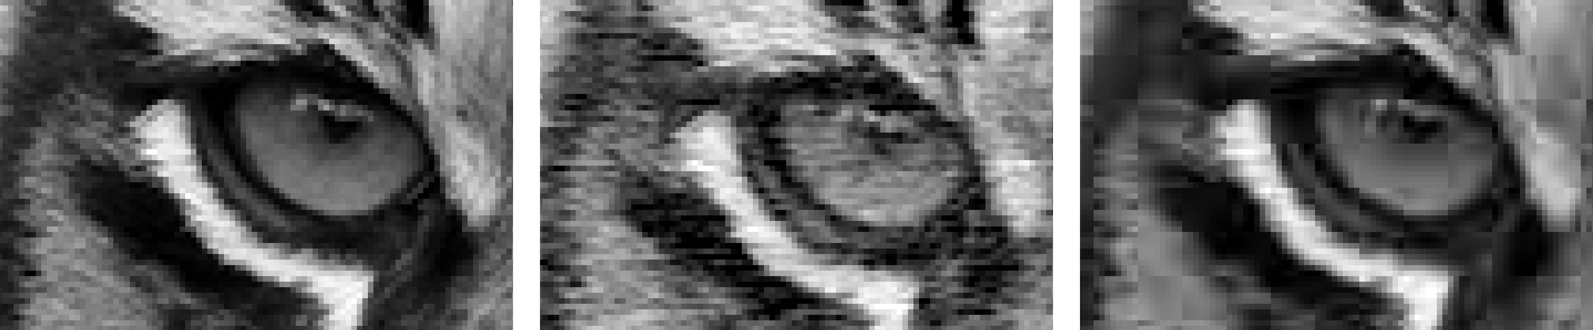
MP3 and JPG on an image (cont)
original
MP3
JPG
Image taken from A. Glassner, Deep Learning, Vol. 2: From Basics to Practice

Slide 10
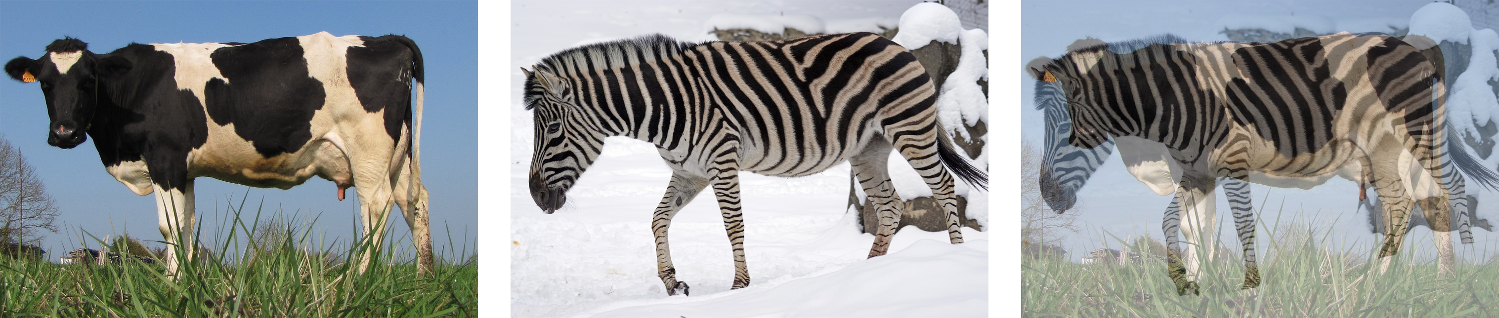
Blending
Blend inputs to create new data that is like the input data, but different.
Content blending. That’s where we blend the content of two pieces of data with each other. For example, if we place a cow and zebra over one another
Image taken from A. Glassner, Deep Learning, Vol. 2: From Basics to Practice

Slide 11
Blending (cont)
Parametric or representation blending:
Work with parameters that describe the object we’re interested in. By blending two sets of parameters, depending on the nature of the parameters and the algorithm we use to create the object, we can create results that blend the inherent qualities of the things themselves

Slide 12
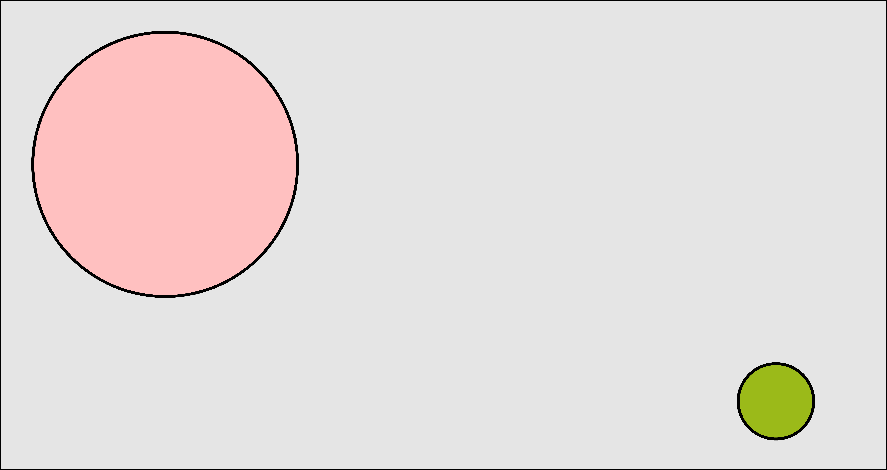
Blending (cont)
Image taken from A. Glassner, Deep Learning, Vol. 2: From Basics to Practice

Slide 13
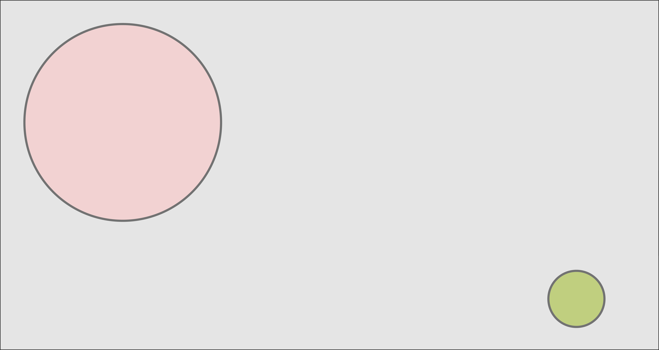
Content blending
Image taken from A. Glassner, Deep Learning, Vol. 2: From Basics to Practice

Slide 14
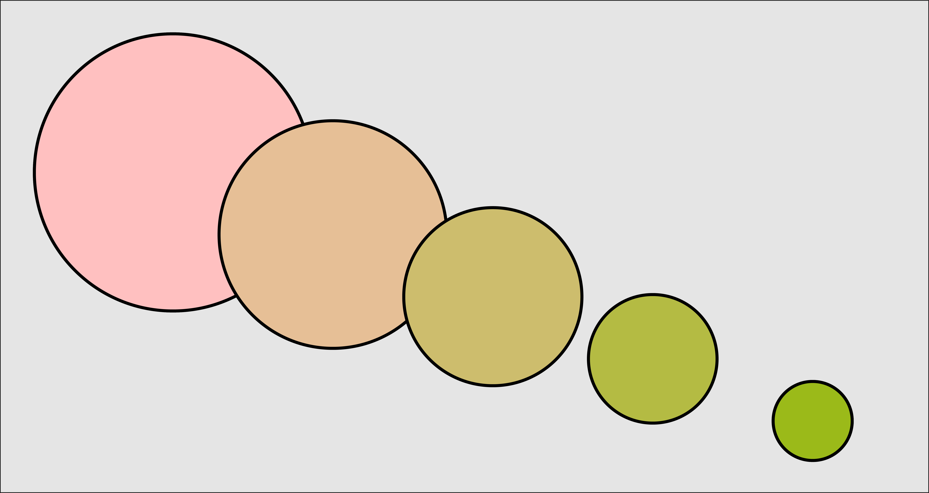
Parametric or representation blending
Image taken from A. Glassner, Deep Learning, Vol. 2: From Basics to Practice

Slide 15
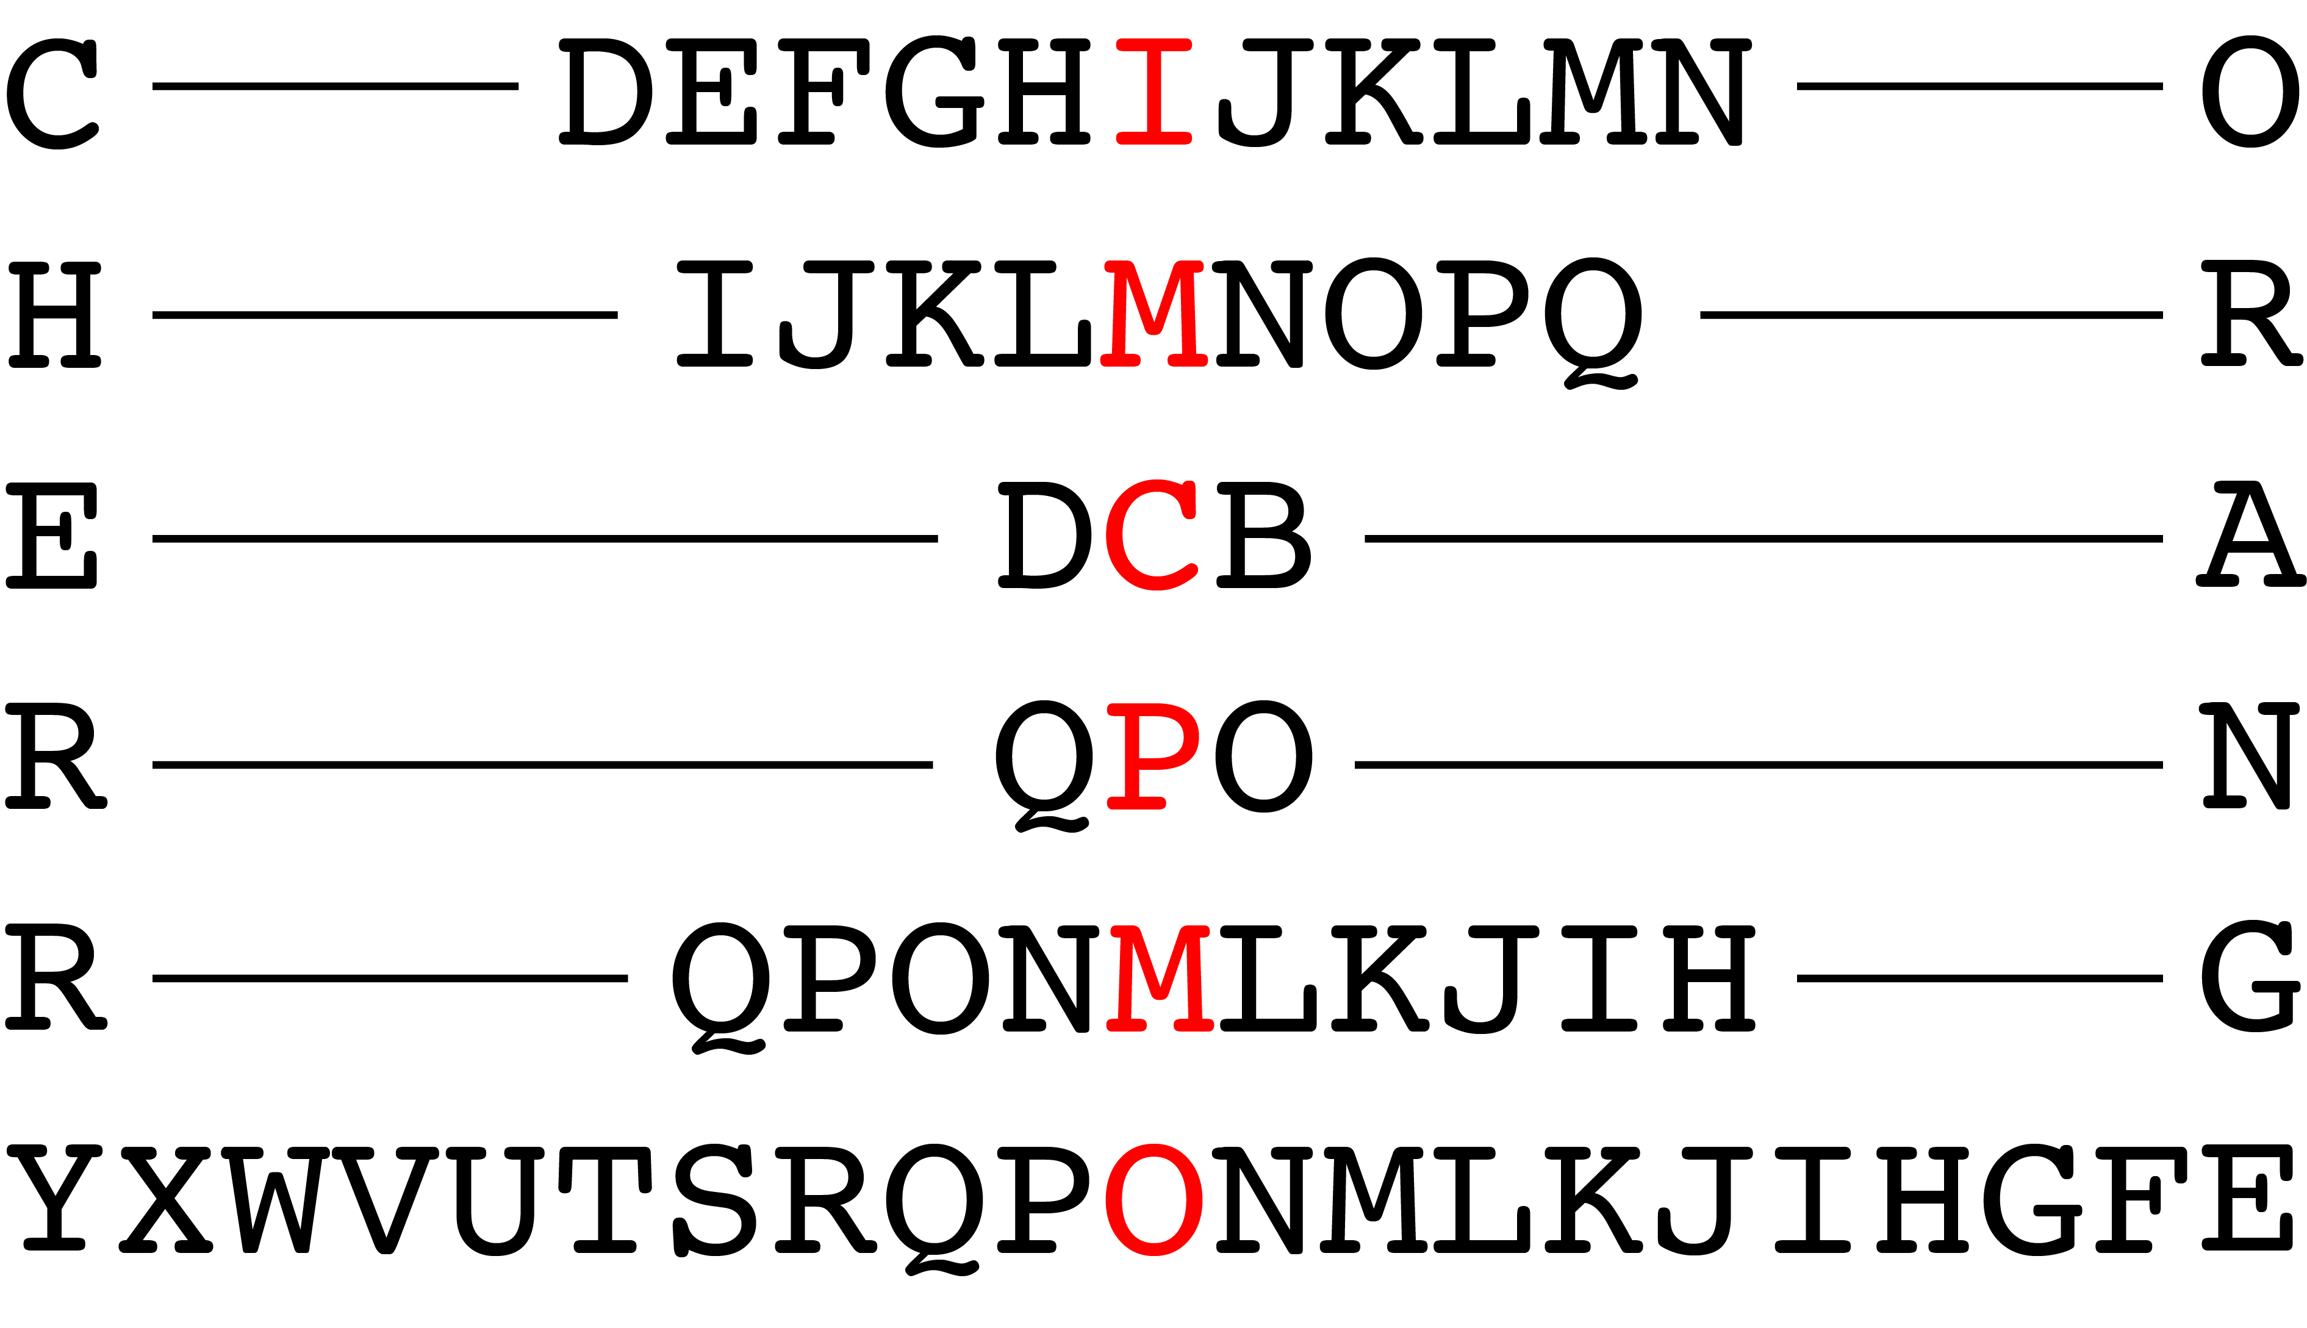
Blending in compressed representation
This works well for uncompressed objects.
What if we try this with compressed objects. The compressed form may not be the best representation with what we would like to blend the objects.
For example, let’s take the sounds of the words cherry and orange.
We can blend these sounds together or we can compressed these sounds into written words.
Image taken from A. Glassner, Deep Learning, Vol. 2: From Basics to Practice

Slide 16
The simplest autoencoder
Encode with a simple fully connected network (FCN)
20 neurons
20 numbers
Image 100x100
FCN with 20 neurons

Slide 17
The simplest autoencoder
Encode and decode
20 neurons
10K neurons
10000 numbers
Image 100x100
FCN: 20 neurons
FCN:10000 neurons
This is an autoencoder. It gets that name because it automatically finds the best way to encode the input so that the decoded version is as close as possible to the input.

Slide 18
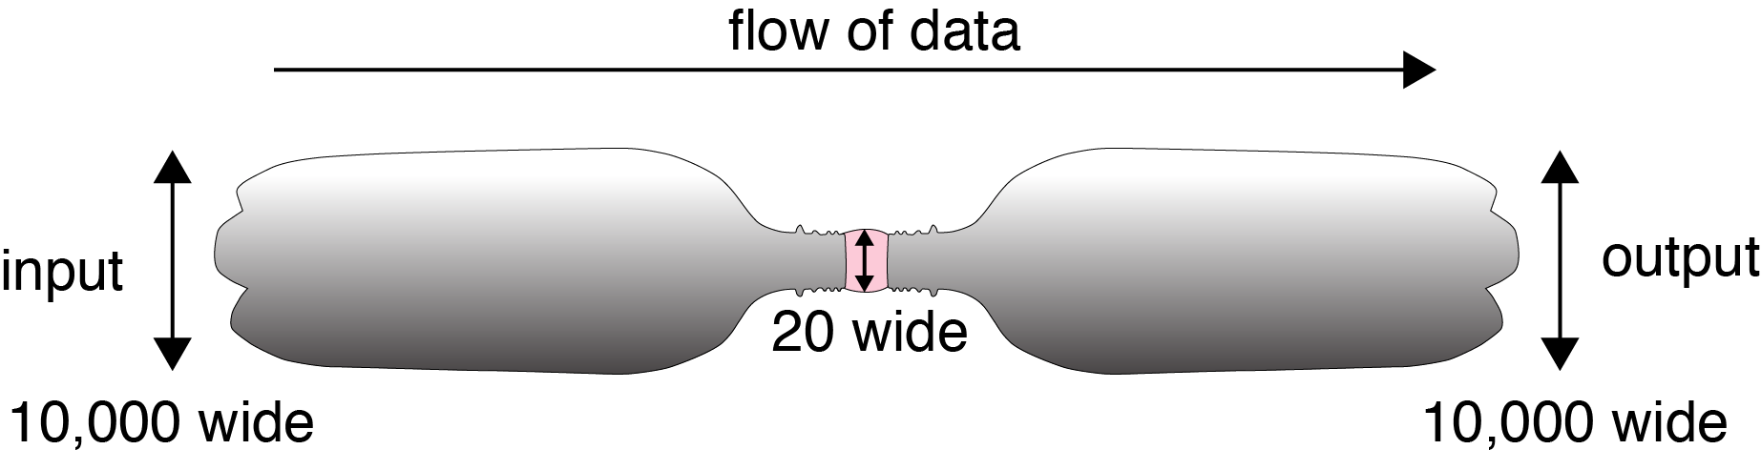
Bottleneck
We start with 10,000 elements
We have 20 in the middle
And 10,000 elements again at the end

Slide 19
Latent variables and latent layer
We say that an autoencoder is an example of semi-supervised learning. It sort-of is supervised learning because we give the system explicit goal data (the output should be the same as the input), and it sort-of isn’t supervised learning because we don’t have any manually determined labels or targets on the inputs.

Slide 20
Autoencoders in action

Slide 21
Autoencoders in action (cont)
20 neurons
10K neurons
Pretty good I say

Slide 22
Autoencoders in action (cont)
20 neurons
10K neurons
Even better

Slide 23
Autoencoders in action (cont)
20 neurons
10K neurons
Hmmmmm

Slide 24
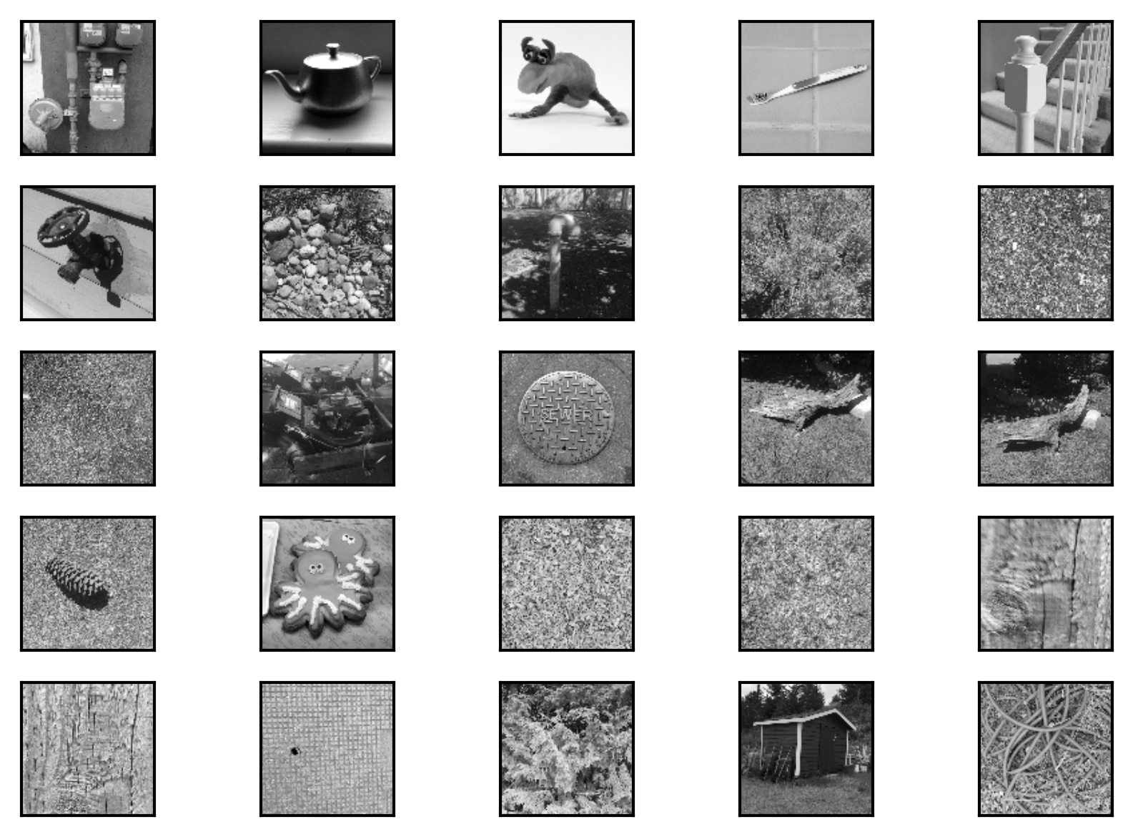
Autoencoders in action (cont)
We must train with a variety of images.

Slide 25
Autoencoders in action (cont)
20 neurons
10K neurons

Slide 26
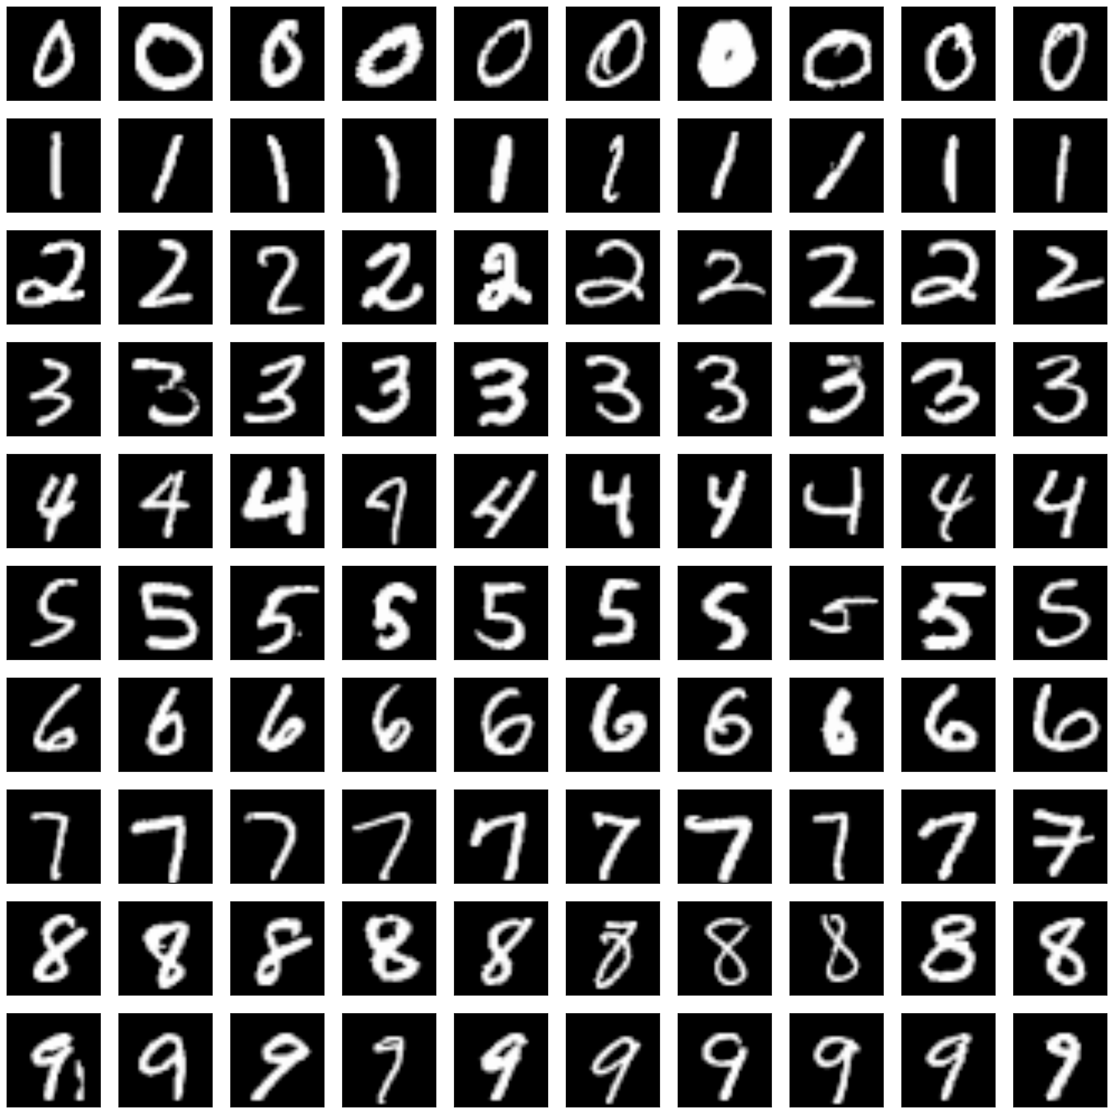
Better autoencoder
20 neurons
784 neurons

Slide 27
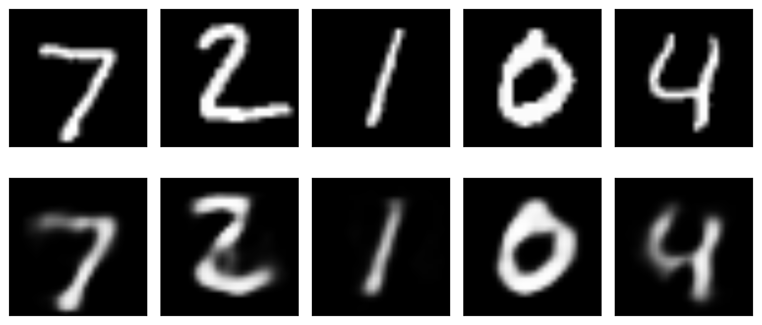
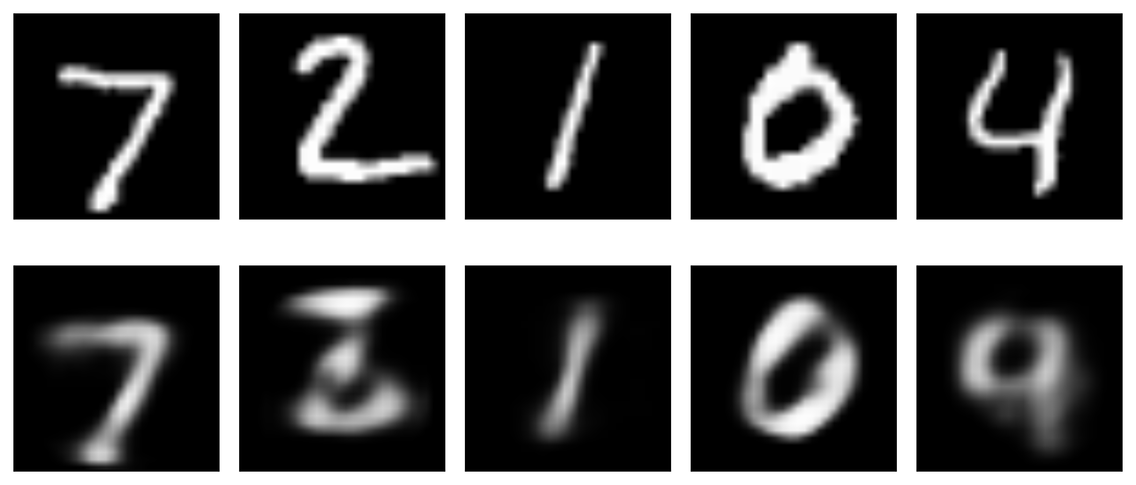
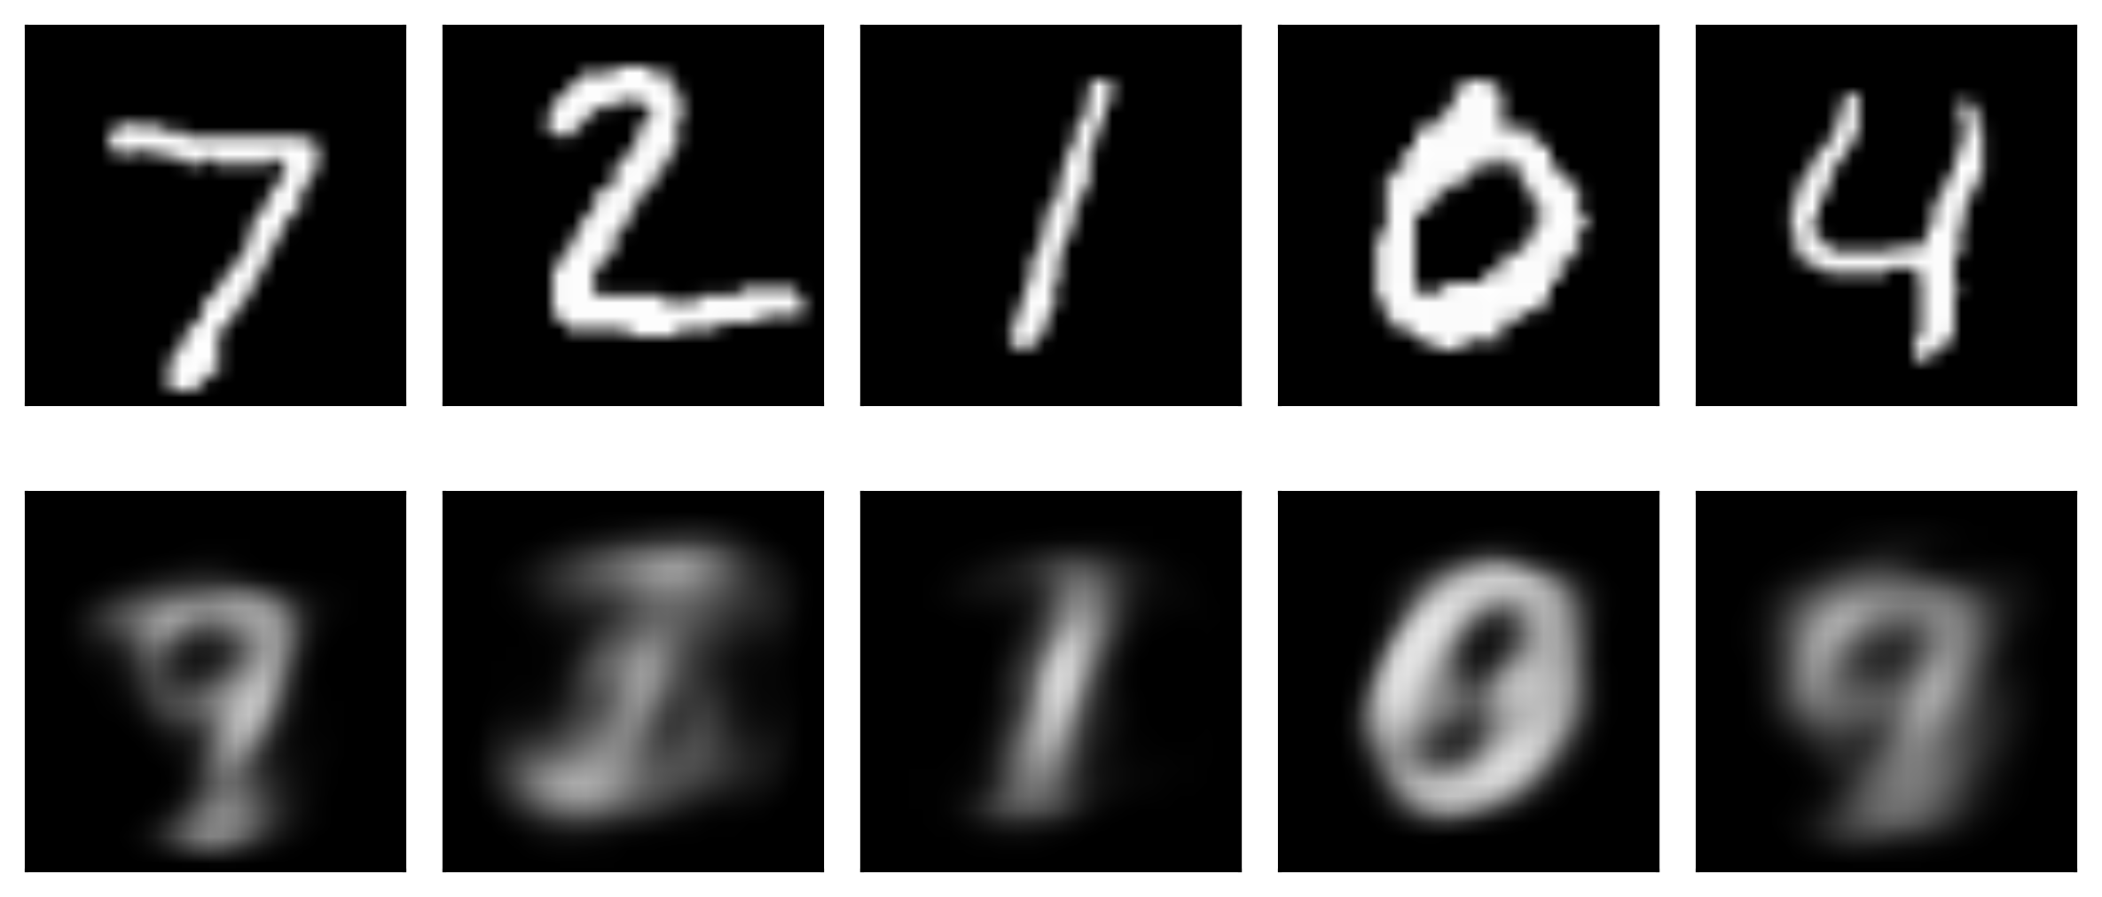
20 latent variables
10 latent variables
2 latent variables
Image taken from A. Glassner, Deep Learning, Vol. 2: From Basics to Practice

Slide 28
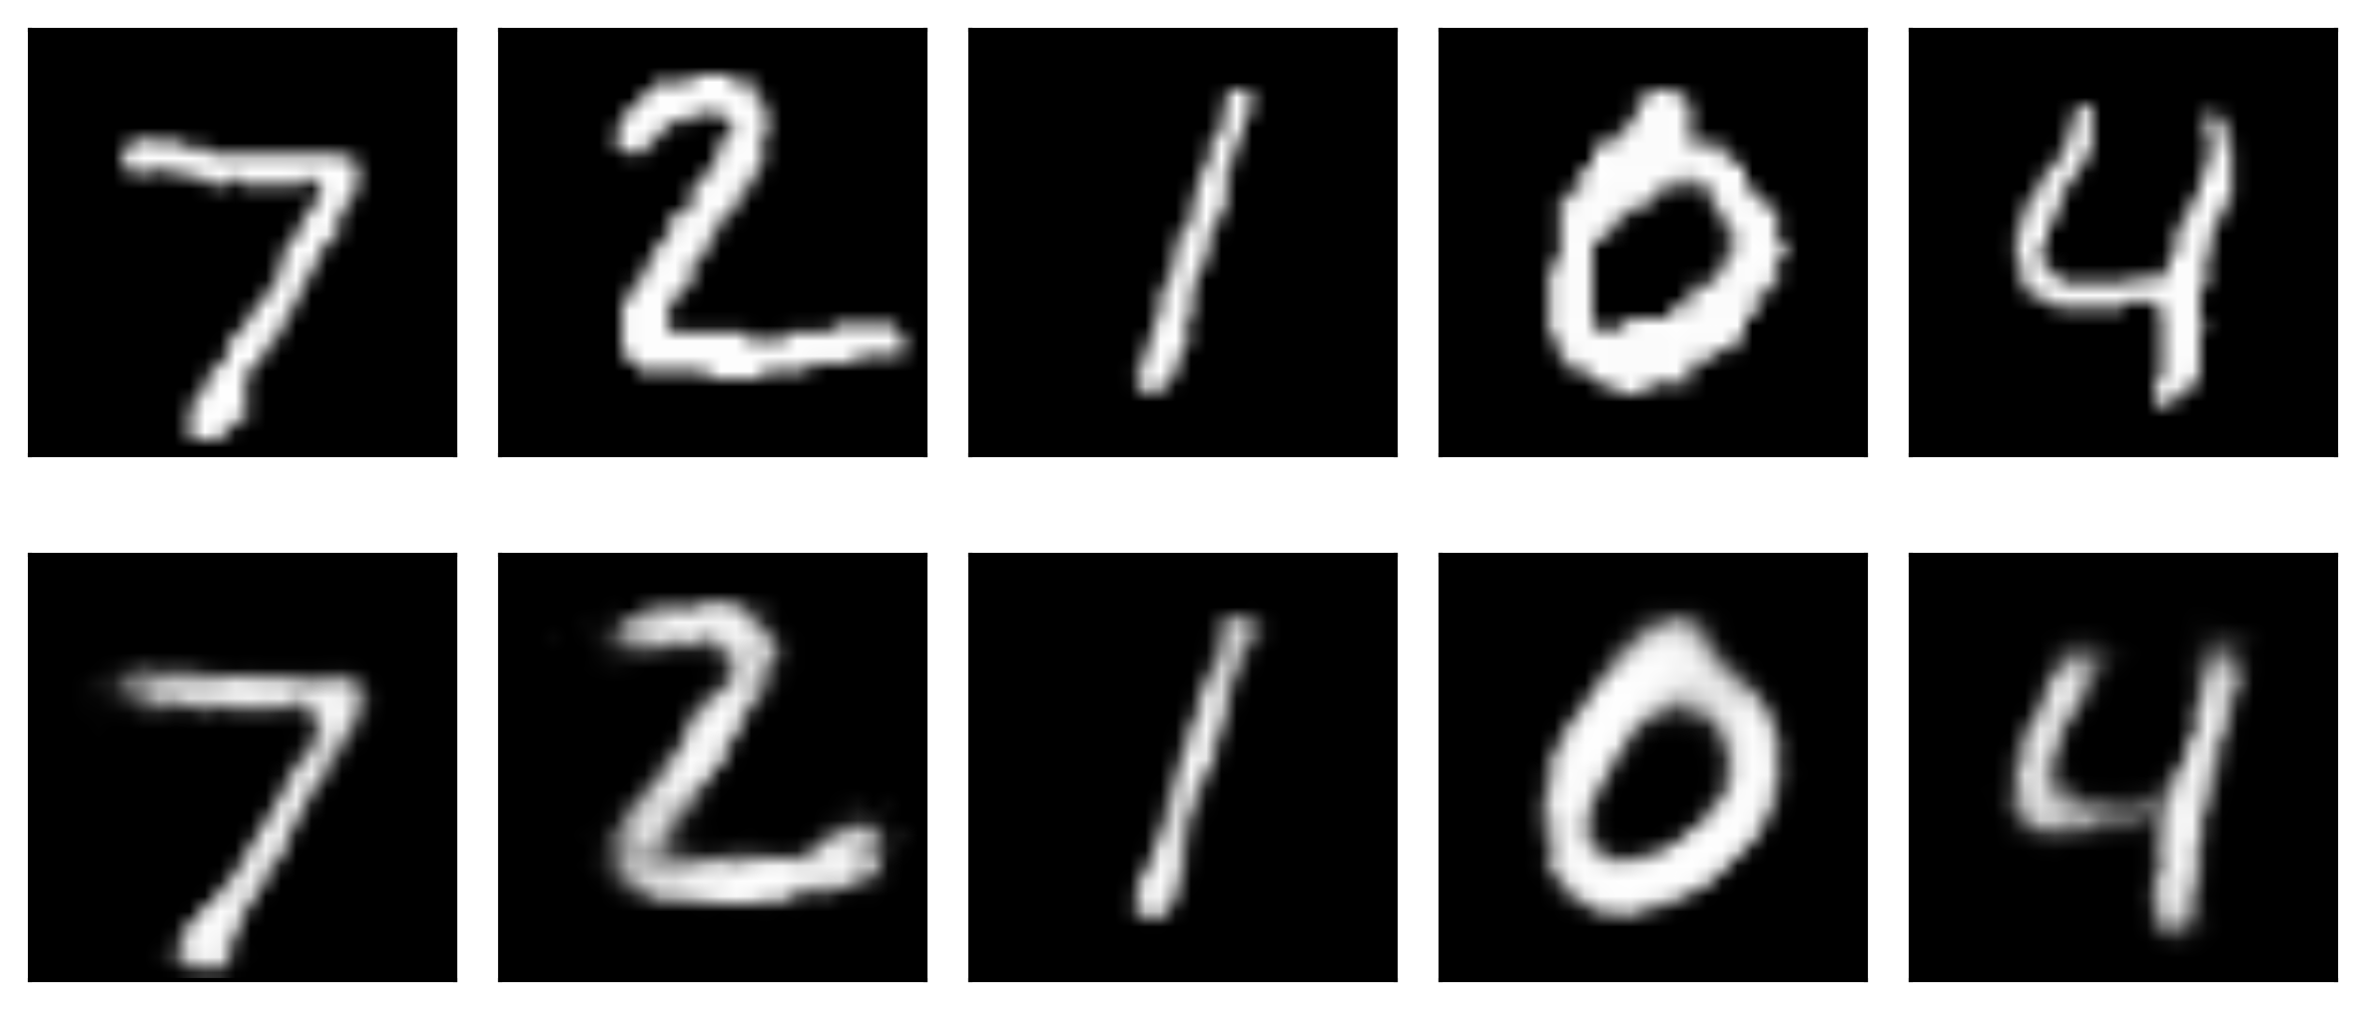
Go deeper
512 neurons
256 neurons
20 neurons
256 neurons
512neurons
784 neurons

Slide 29
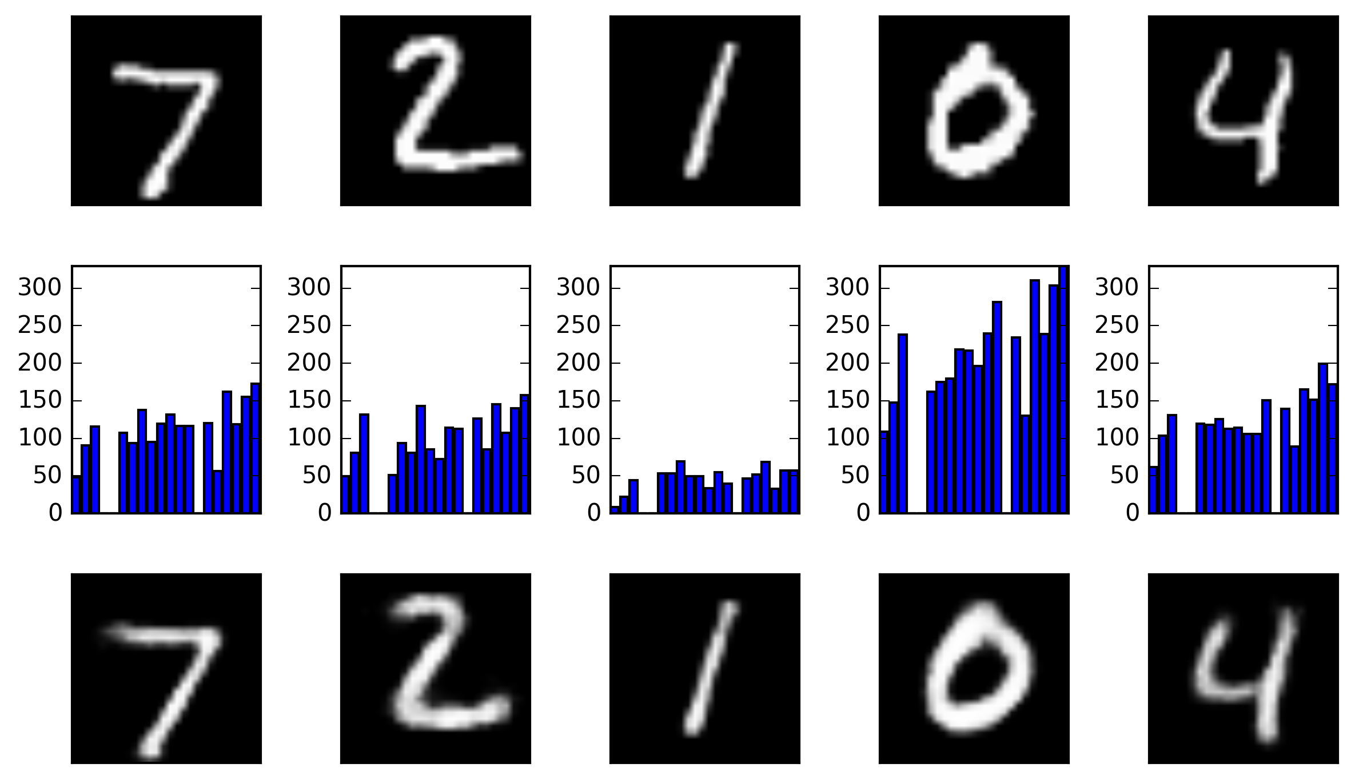
Exploring autoencoders

Slide 30
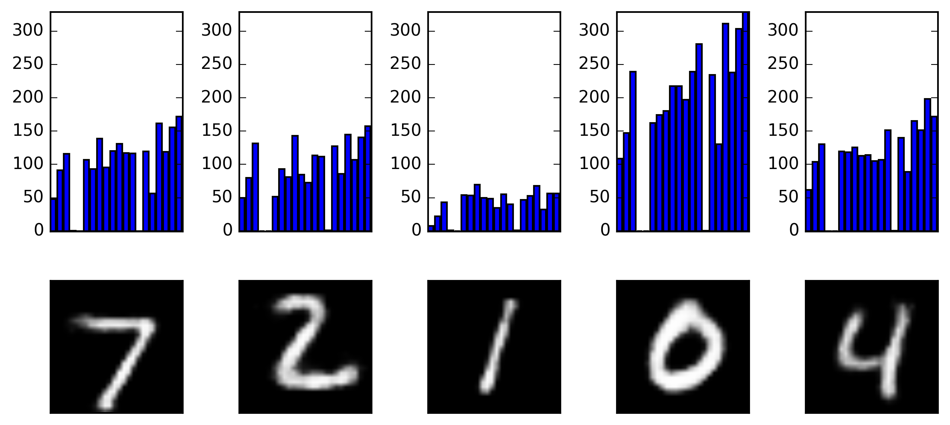
Exploring autoencoders
Change +/- 1 the latent variables

Slide 31

Exploring autoencoders
Change +/- 10 the latent variables

Slide 32
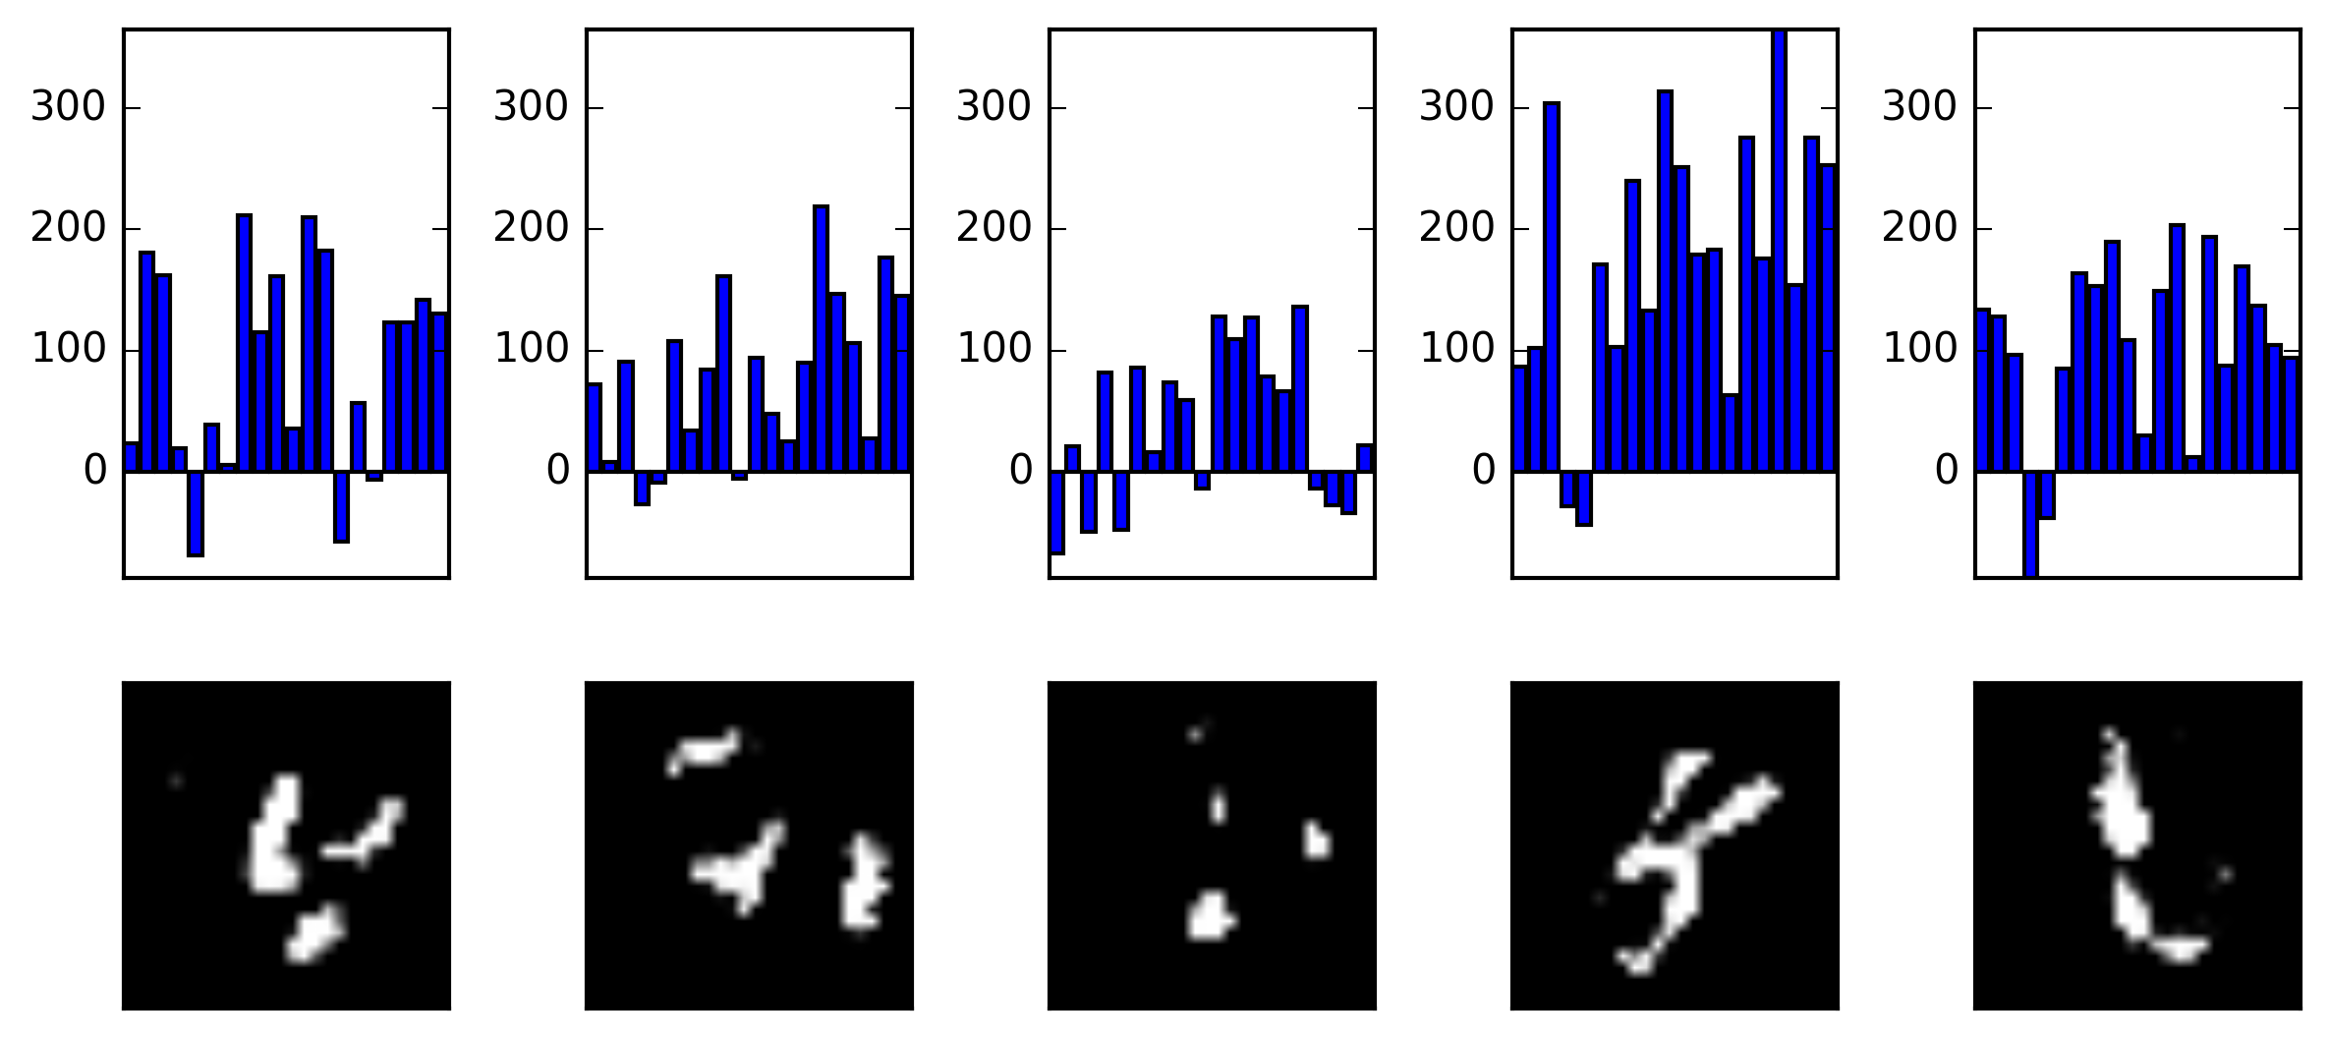
Exploring autoencoders
Change +/- 100 the latent variables

Slide 33
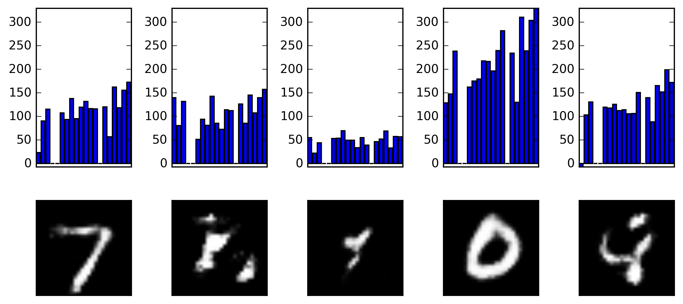
Exploring autoencoders
Change +/- 100 the first latent variables

Slide 34
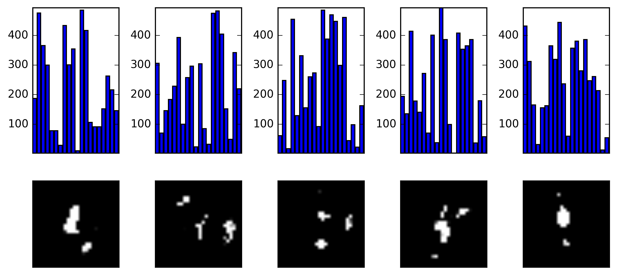
Exploring autoencoders
Just noise

Slide 35
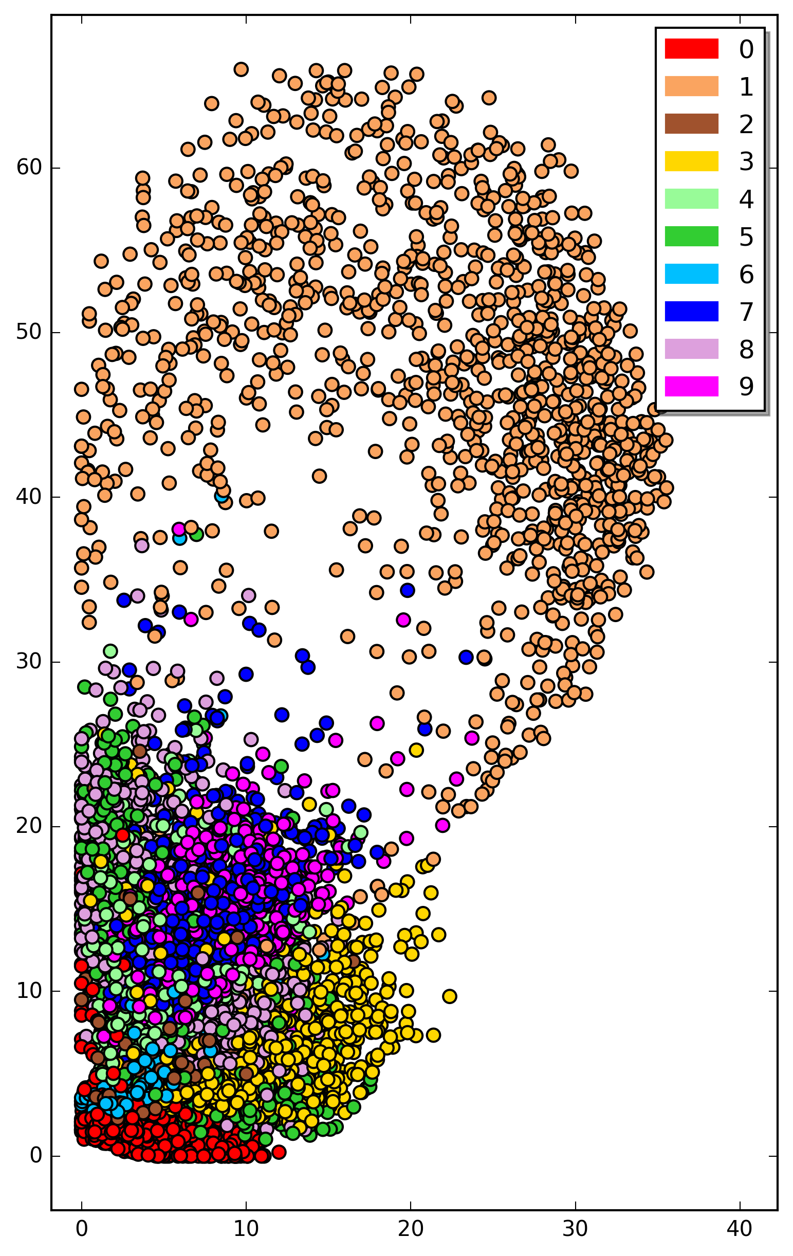
Parameter space of autoencoder

Slide 36
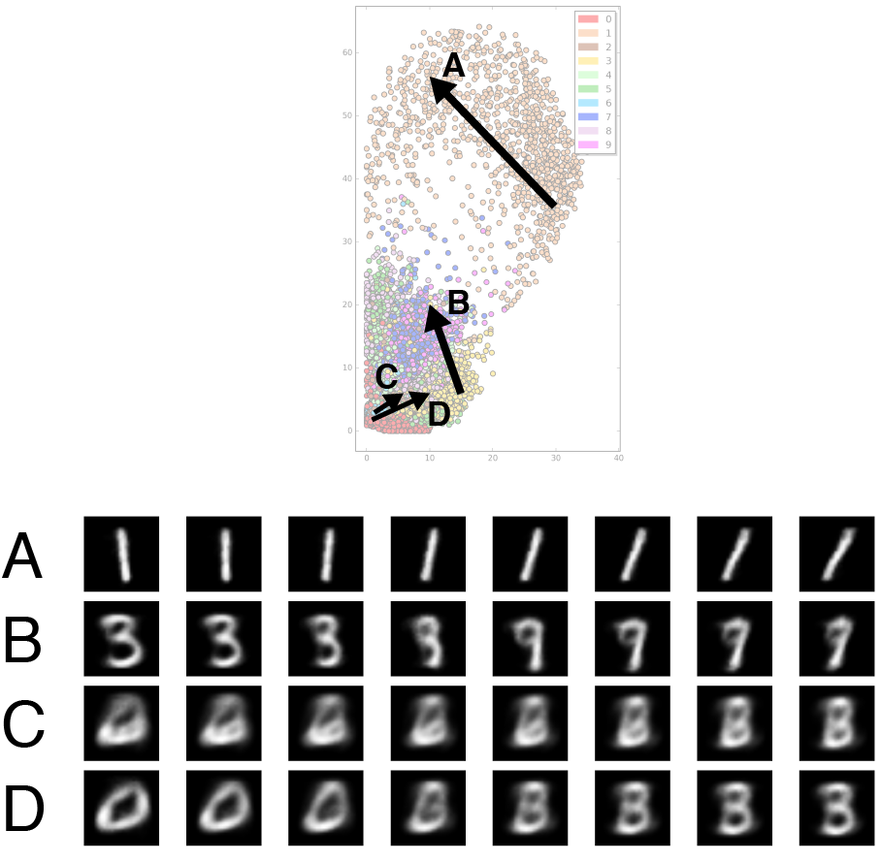
Blending Latent Variables

Slide 37
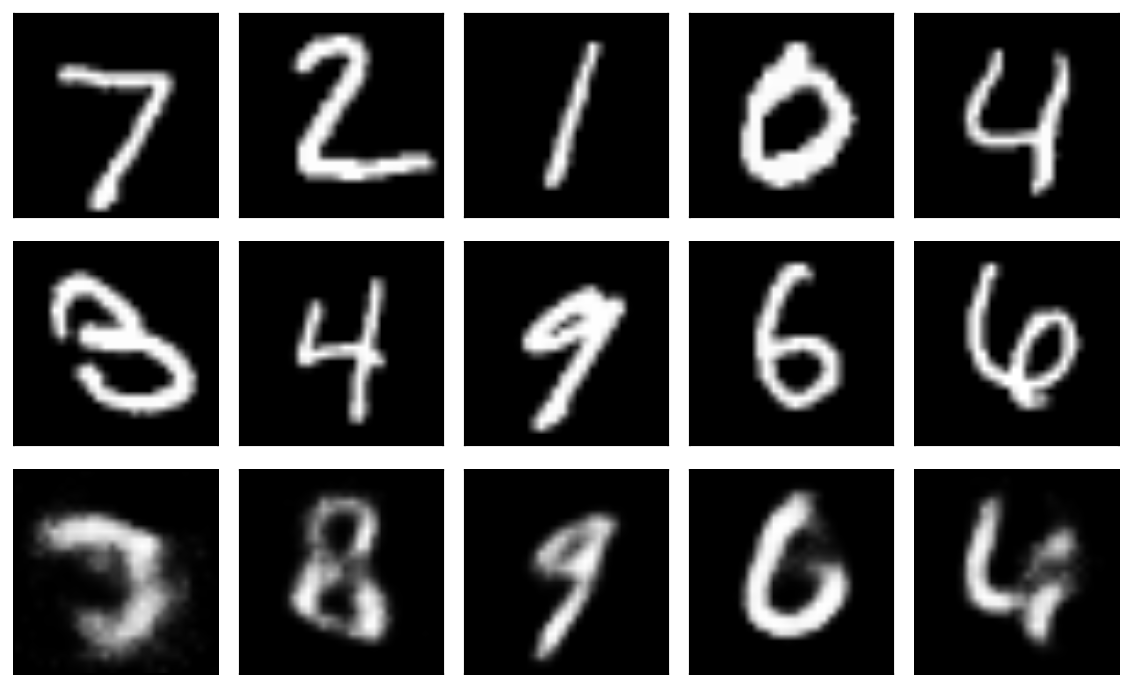
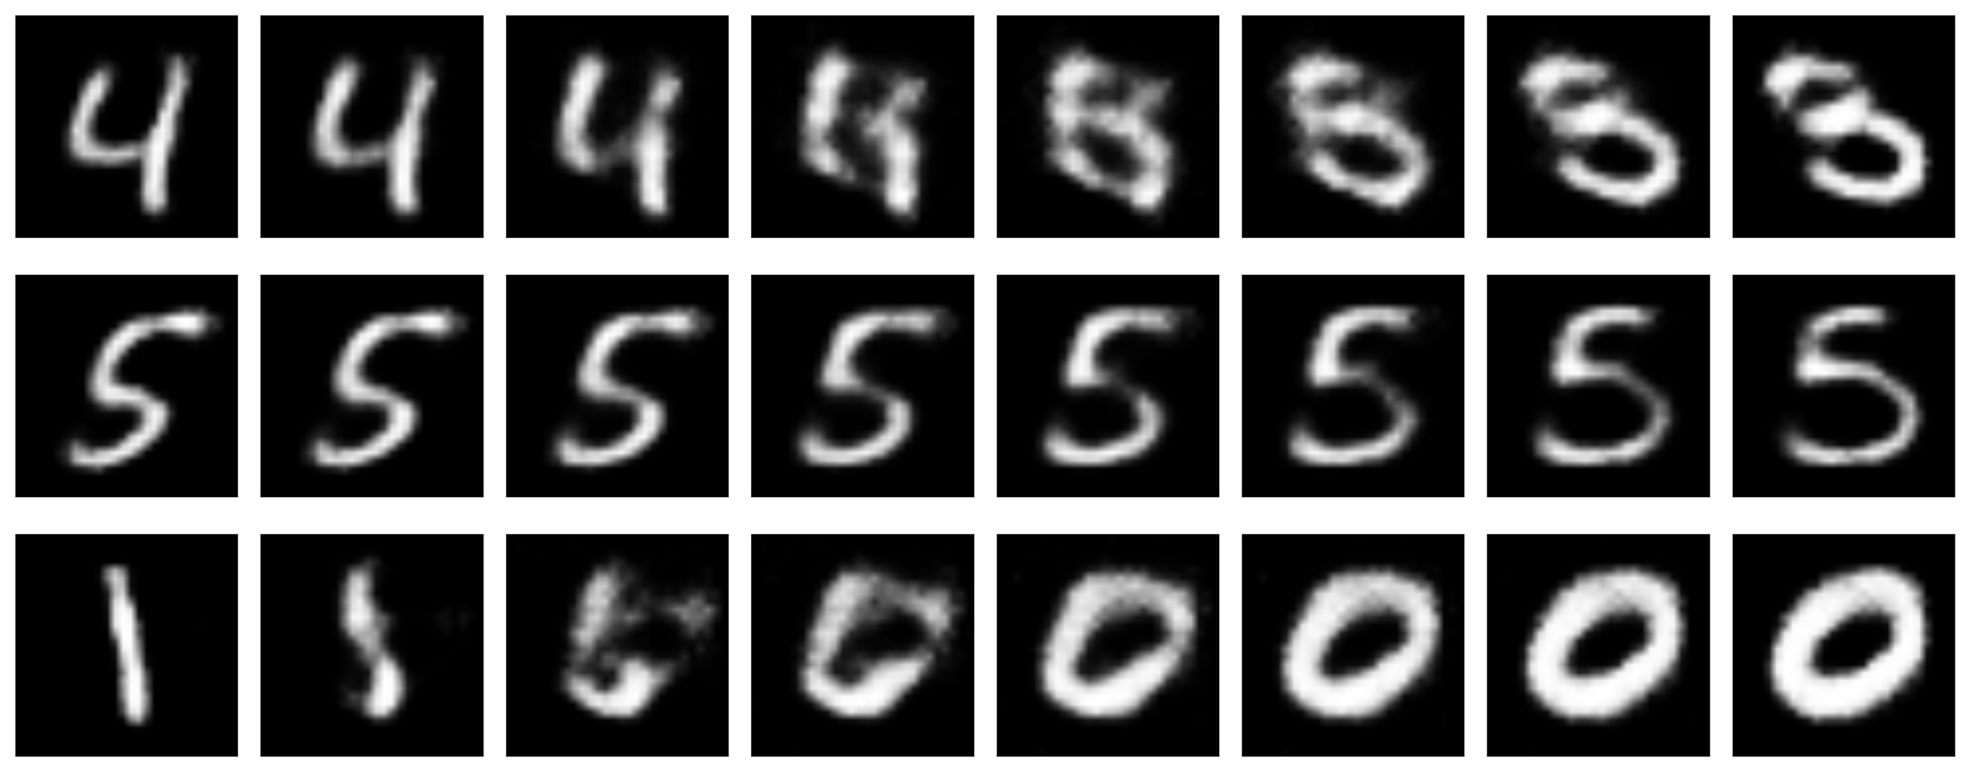
Blending Latent Variables

Slide 38
Applying to novel input
512 neurons
256 neurons
20 neurons
256 neurons
512neurons
784 neurons

Slide 39
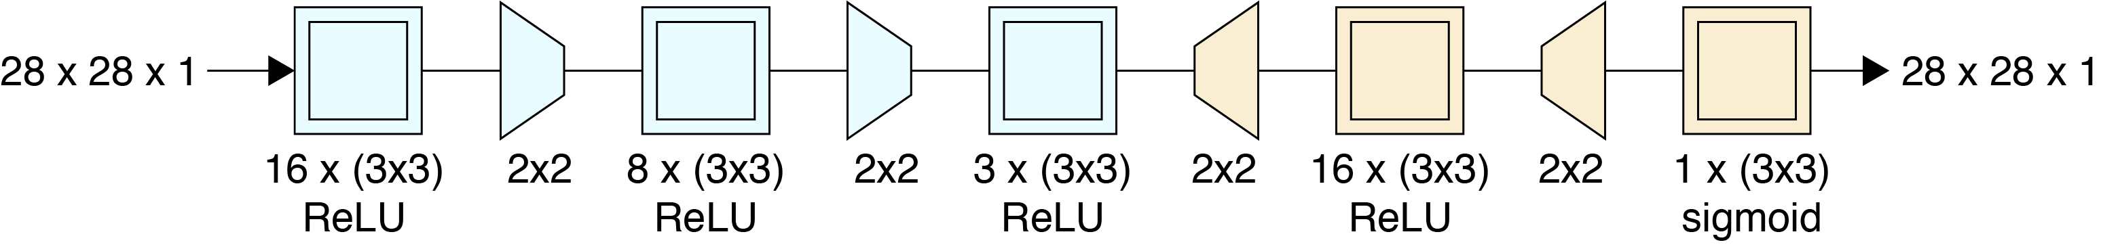
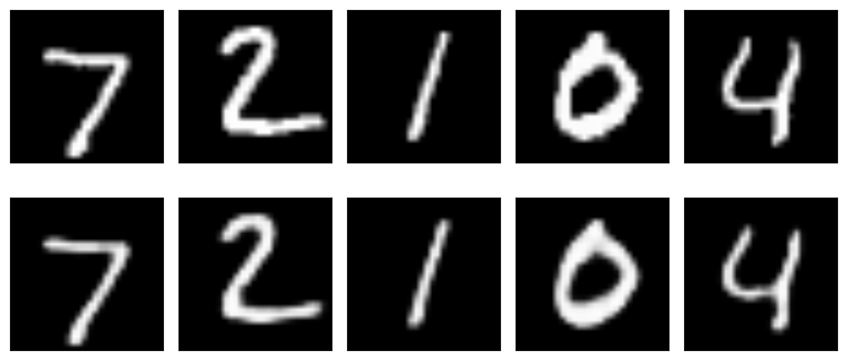
Convolutional Autoencoders

Slide 40
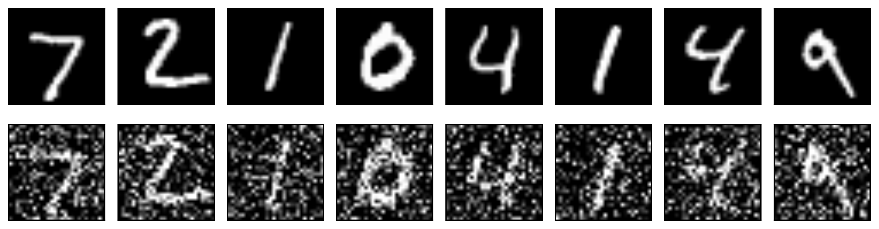
Denoising
A popular use of autoencoders is to remove noise from samples.

Slide 41
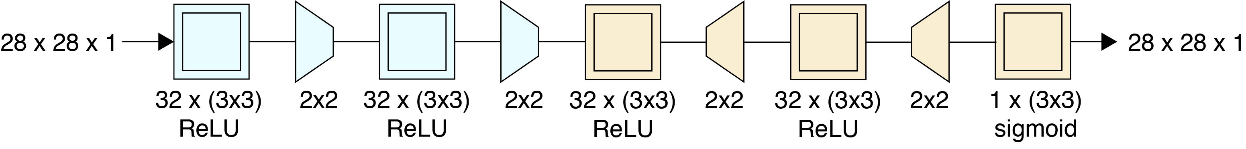
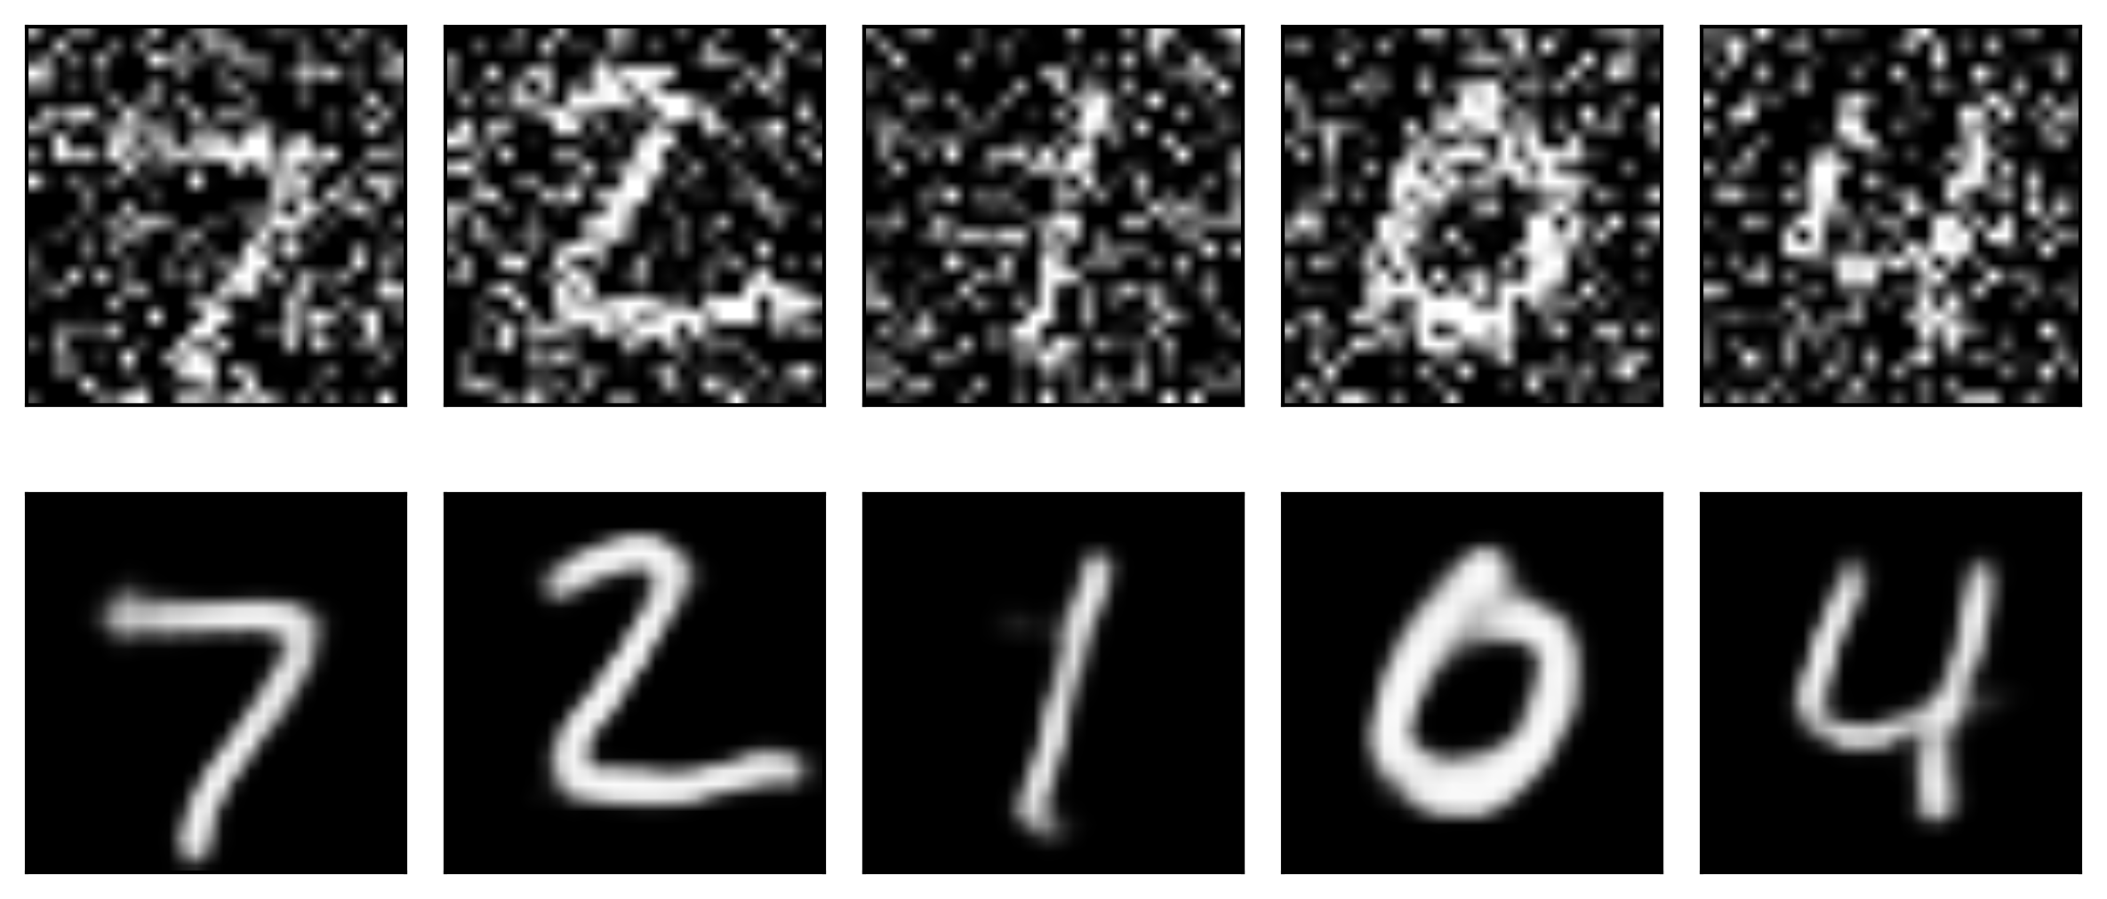
Denoising (cont)
A little strange that instead of bottleneck we have the opposite here.

Slide 42
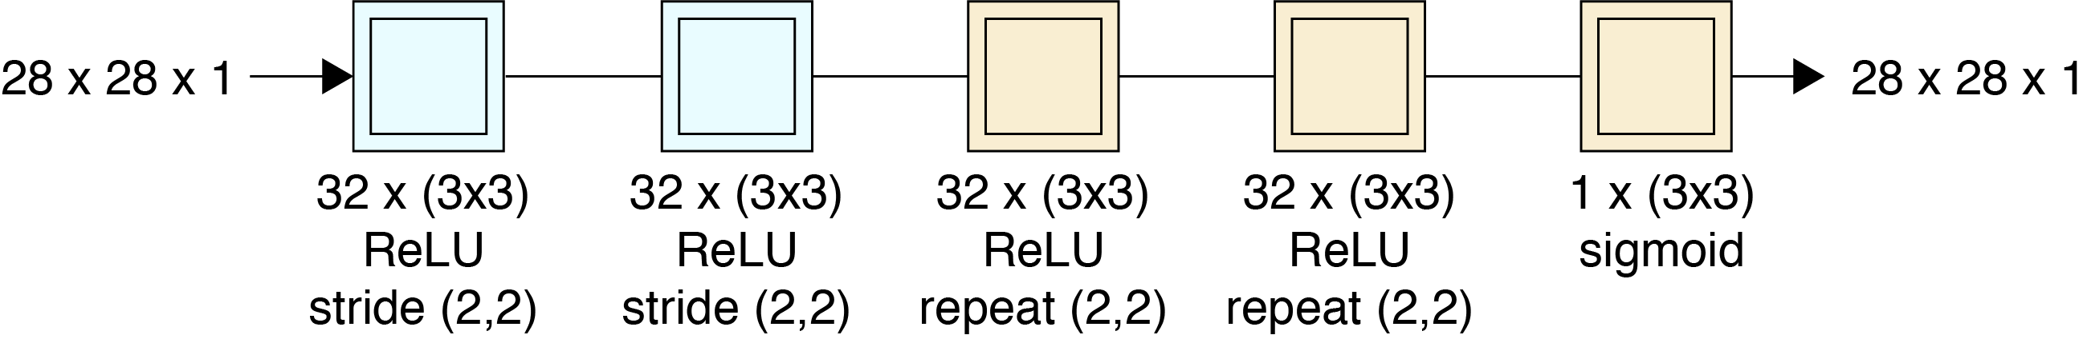
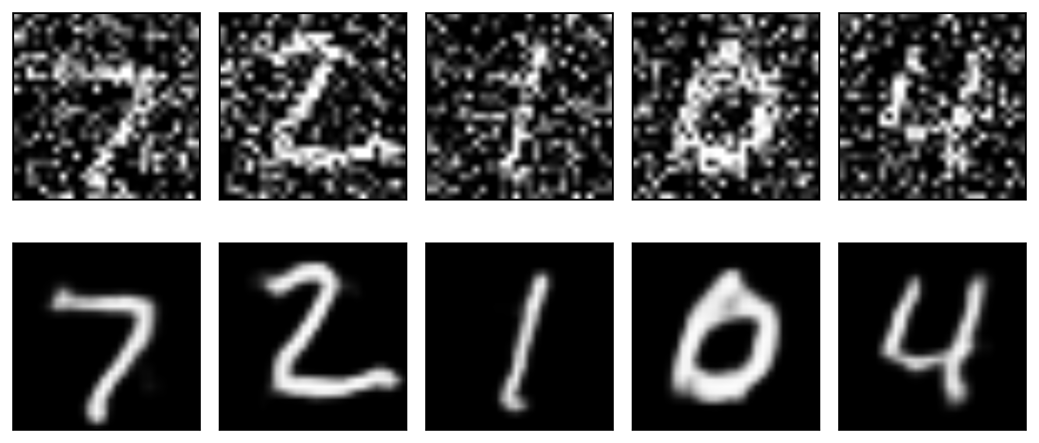
Denoising (cont)
Simpler model

Slide 43
Generative Models

Slide 44
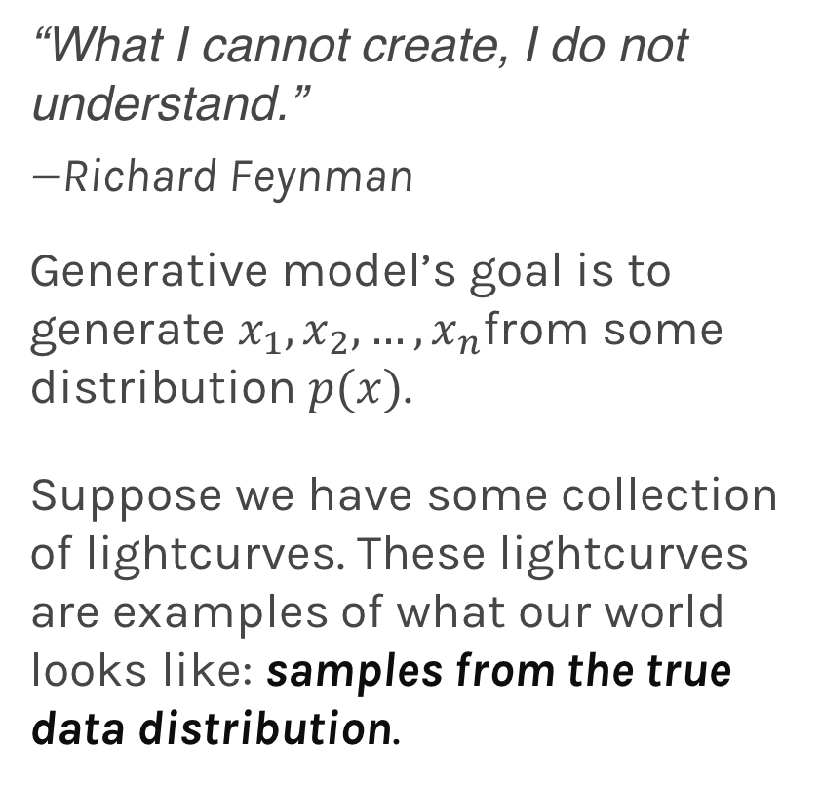
Generative models
“What I cannot create, I do not understand.”
—Richard Feynman
Generative model’s goal is to generate $x_{1},x_{2},…,x_{n}$from some distribution $p(x)$.
Suppose we have some collection of lightcurves. These lightcurves are examples of what our world looks like: samples from the true data distribution.

Slide 45
Generative models
We would like to construct our generative model, which we would like to train to generate lightcurves like these from scratch.
A generative model in this case could be one large neural network that outputs lightcurves: samples from the model.
Deep Generative Models
Explicit Density
Markov Chain
Implicit Density
Markov Chain
Direct
Variational
Boltzmann Machines
Deep Belief Networks
Variational
Auto-encoders (VAE)
Generative Adversarial Networks (GAN)
Generative Moment Matching Networks (GMM)

Slide 46
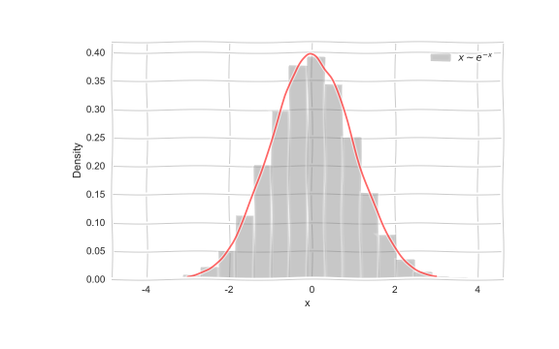
Generative models
Imagine we want to generate data from a distribution,
e.g.

Slide 47
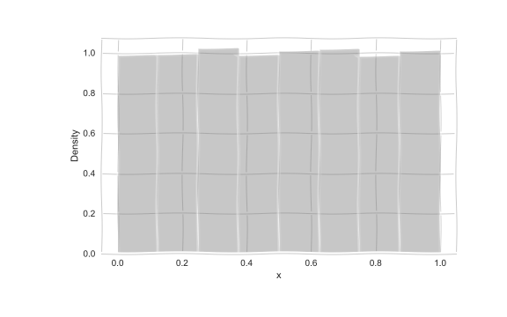
Generative models
But how do we generate such samples?
Imagine we want to generate:
We start with

Slide 48
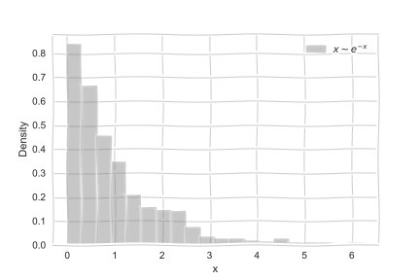
Generative models
The we transform:

Slide 49
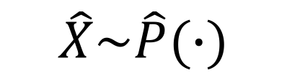
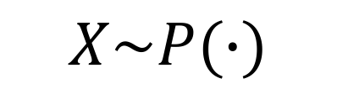
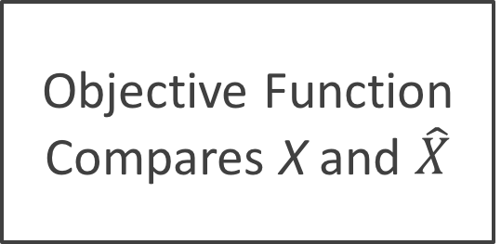
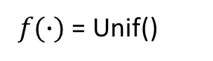
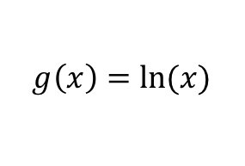
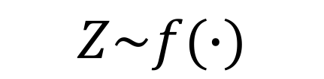
Generative models
Generator
g(X)
$$Z\sim f(∙)$$
$$\hat{X}\sim \hat{P}(∙)$$
$f(∙)$ = Unif()
Objective Function Compares X and $\hat{X}$
$$g\left(x\right)=ln⁡(x)$$
Either a likelihood or KL divergence, etc
$$X\sim P(∙)$$

Slide 50
Outline
Why do we care about training sets
How do we generate training sets
Overview of transfer learning and domain adaptation
Generative models
NN Generative Models
Our method
Results

Slide 51

Autoencoders
Neural net that approximately copies its input to output
Encodes useful info about data

Slide 52
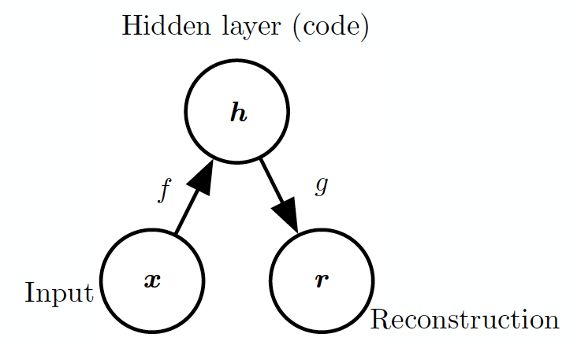
Structure of Autoencoders

Slide 53
Undercomplete Autoencoders
h has lower dimension than x
Must discard some information in h
Learning involves minimizing loss:
Equivalent to PCA when f is linear, L is MSE

Slide 54
Overcomplete Autoencoders
h has greater dimension than x
Autoencoder may simply copy input to output without learning anything useful
Regularization to limit model capacity

Slide 55
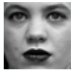
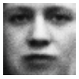
Variational Autoencoders
Encoder
z
Decoder

Slide 56
Variational Autoencoders
Encoder
z
Decoder

Slide 57
Variational Autoencoder
Sample from P(z)
Standard Gaussian
z
Decoder
P(x|z)

Slide 58
VAE Likelihood
Neural network
Difficult to approximate in high dim through sampling
For most z values p(x|z) close to 0

Slide 59
VAE Likelihood
Another neural net
Proposal distribution:
Likely to produce values of x for which p(x|z) is non-zero

Slide 60
VAE Architecture
q_{ϕ}(z|x)
Encoder
z
Decoder
p_{θ}(x|z)
Notes:
http://kvfrans.com/variational-autoencoders-explained/
https://arxiv.org/pdf/1606.05908.pdf

Slide 61
VAE Loss
Proposal distribution should resemble a Gaussian
Reconstruction Loss

Slide 62
VAE Loss
Proposal distribution should resemble a Gaussian
Reconstruction Loss

Slide 63
VAE Loss
Proposal distribution should resemble a Gaussian
Reconstruction Loss
Variational upper bound on loss we care about!

Slide 64
Training VAE
Apply stochastic gradient descent
Sampling step not differentiable
Use a re-parameterization trick
Move sampling to input layer, so that the sampling step is independent of the model

Slide 65
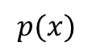
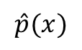
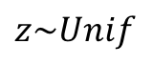
Generative Adversarial Networks
Generated distribution
True distribution
$$\hat{p}(x)$$
$$p(x)$$
Generative Model
(Neural Network)
W_{G}
$$z\sim Unif$$
Loss function
KL Divergence

Slide 66
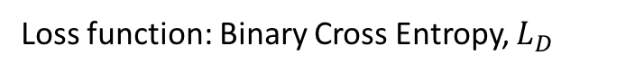
Generative Adversarial Networks
Generated distribution
True distribution
$$\hat{p}(x)$$
$$p(x)$$
Generative Model
(Neural Network)
W_{G}
Discriminator
(Neural Network)
W_{D}
$$z\sim Unif$$
From Generator
From True Distribution
Loss function
KL Divergence
Loss function: Binary Cross Entropy, $L_{D}$

Slide 67
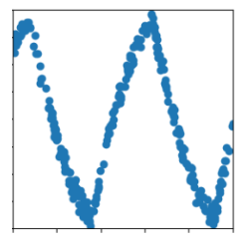
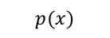
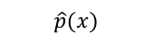
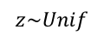
Generative Adversarial Networks
Generated distribution
True distribution
$$\hat{p}(x)$$
$$p(x)$$
Generative Model
(Neural Network)
$$z\sim Unif$$
Discriminator
(Neural Network)
From Generator
From True Distribution

Slide 68

Generative Adversarial Networks
Generated distribution
True distribution
$$\hat{p}(x)$$
$$p(x)$$
Generative Model
(Neural Network)
$$z\sim Unif$$
Discriminator
(Neural Network)
From Generator
From True Distribution

Slide 69

Generative Adversarial Networks
Generated distribution
True distribution
$$\hat{p}(x)$$
$$p(x)$$
Generative Model
(Neural Network)
$$z\sim Unif$$
Adjust
weights by
$$∇_{W_{G}}L_{D}$$
Discriminator
(Neural Network)
Generator
Loss
From Generator
From True Distribution

Slide 70

Generative Adversarial Networks
Generated distribution
True distribution
$$\hat{p}(x)$$
$$p(x)$$
Generative Model
(Neural Network)
$$z\sim Unif$$
Discriminator
(Neural Network)
From Generator
From True Distribution

Slide 71

Generative Adversarial Networks
Generated distribution
True distribution
$$\hat{p}(x)$$
$$p(x)$$
Generative Model
(Neural Network)
$$z\sim Unif$$
Discriminator
(Neural Network)
Adjust
weights by
$$∇_{W_{G}}L_{D}$$
Generator
Loss
From Generator
From True Distribution

Slide 72

Generative Adversarial Networks
Generated distribution
True distribution
$$\hat{p}(x)$$
$$p(x)$$
Generative Model
(Neural Network)
$$z\sim Unif$$
Discriminator
(Neural Network)
From Generator
From True Distribution

Slide 73

Generative Adversarial Networks
Generated distribution
True distribution
$$\hat{p}(x)$$
$$p(x)$$
Generative Model
(Neural Network)
$$z\sim Unif$$
Adjust
weights by
$$∇_{W_{D}}L_{D}$$
Discriminator
(Neural Network)
Discriminator
Loss
From Generator
From True Distribution

Slide 74


Generative Adversarial Networks
Generated distribution
True distribution
$$\hat{p}(x)$$
$$p(x)$$
Generative Model
(Neural Network)
$$z\sim Unif$$
Discriminator
(Neural Network)
Adjust
weights by
$$∇_{W_{G}}L_{D}$$
Generator
Loss
From Generator
From True Distribution

